Slide 1
Data-driven estimation of retention rate for clinical trials
Marirena Bafaloukou

Slide 2

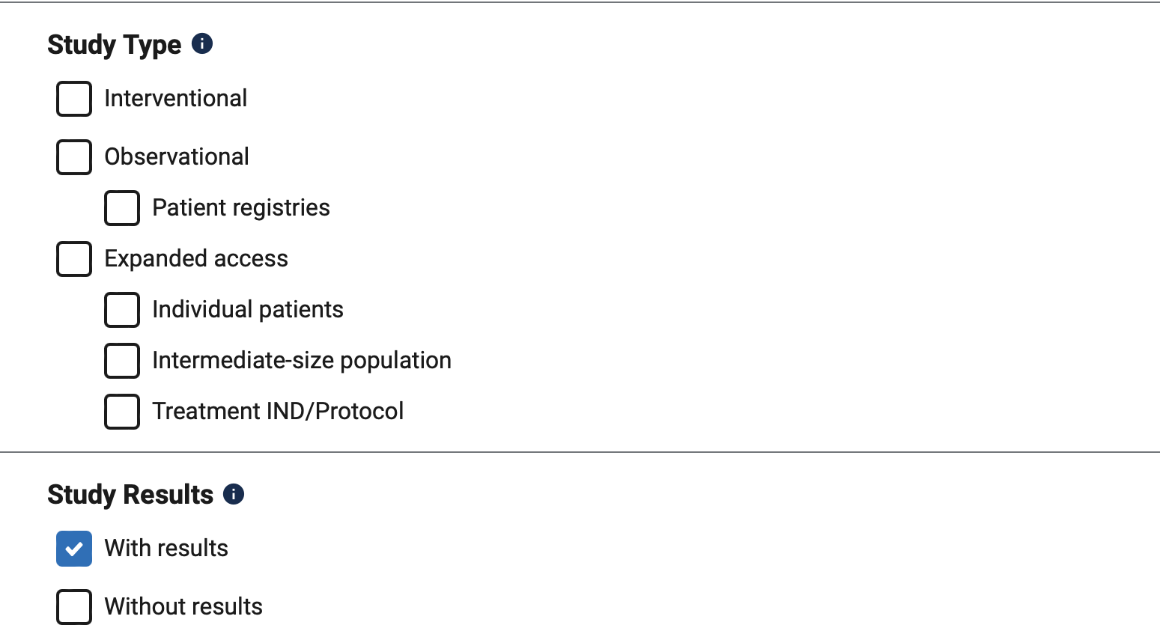
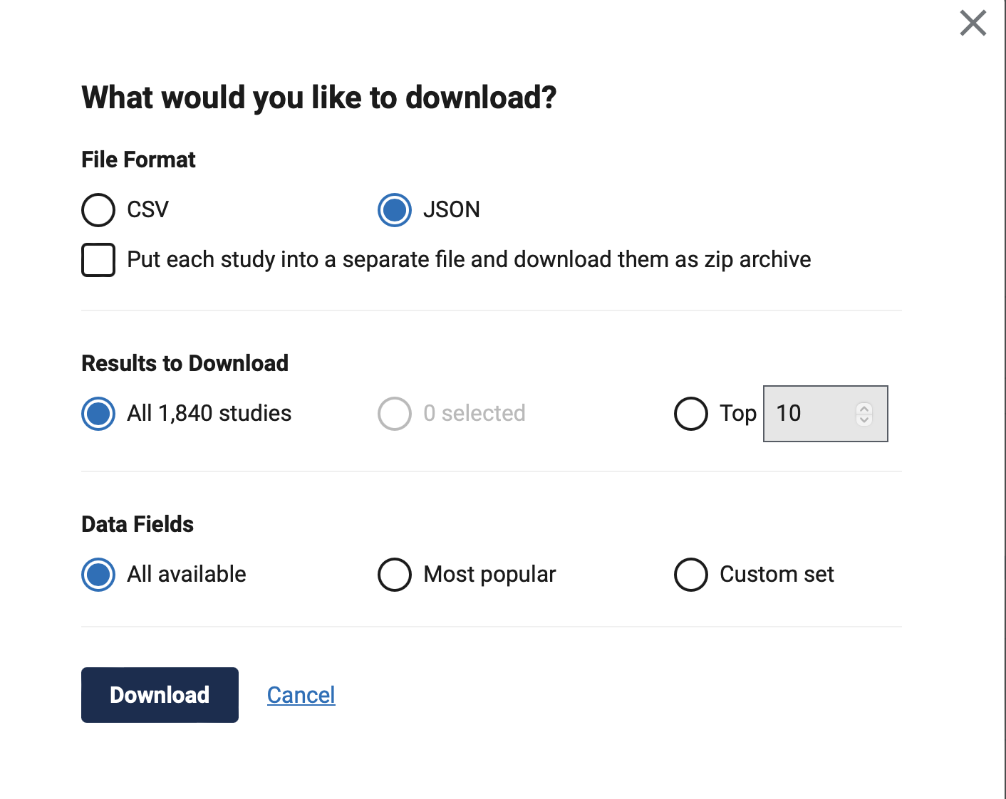
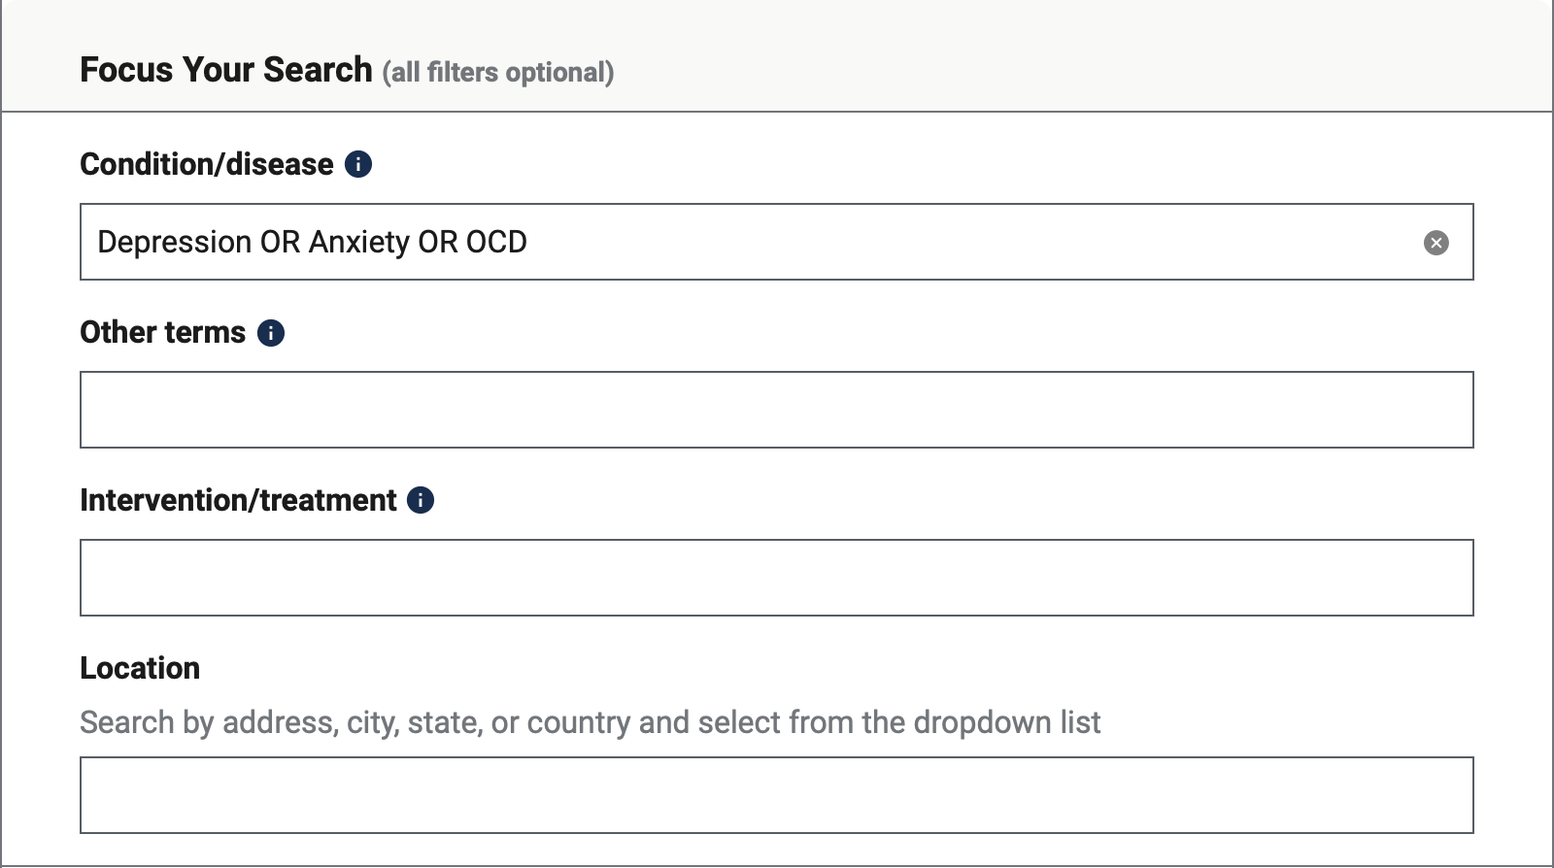
Data acquisition
Query from
Results
Specific condition or set of conditions

Slide 3

Which parameters affect retention in clinical trials?
Top 40 reasons for withdrawal
Text mining techniques on
publications : Word pairwise correlation across publications
Words of interest: retention OR withdrawal
Consultation with healthcare professionals and clinicians
Simple literature search

Slide 4
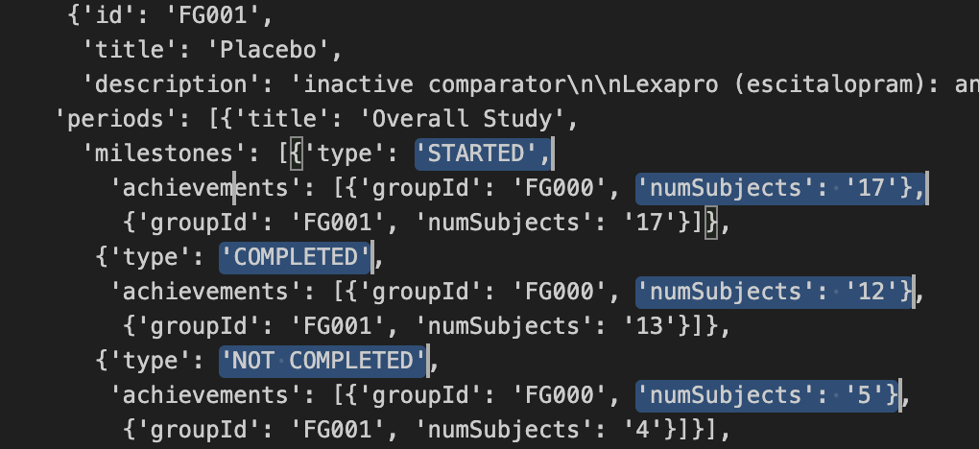
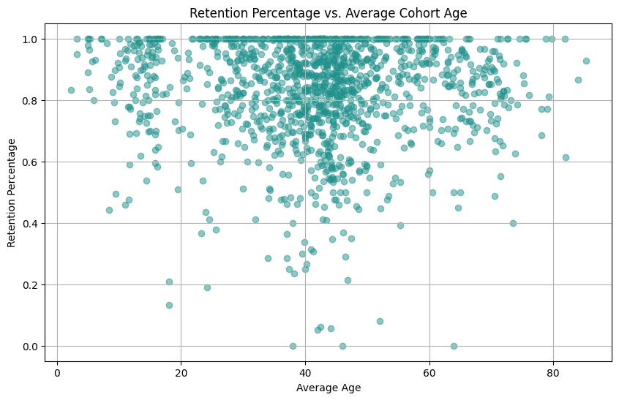
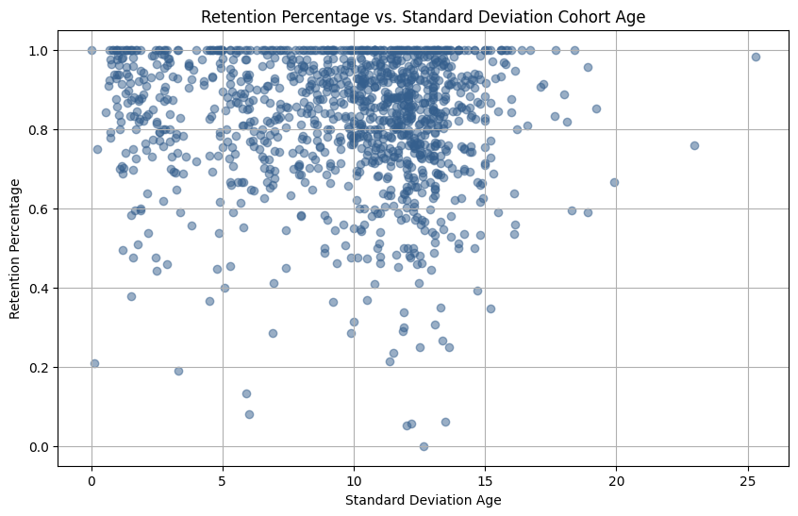
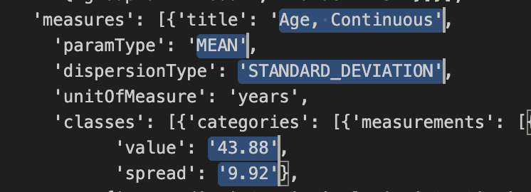
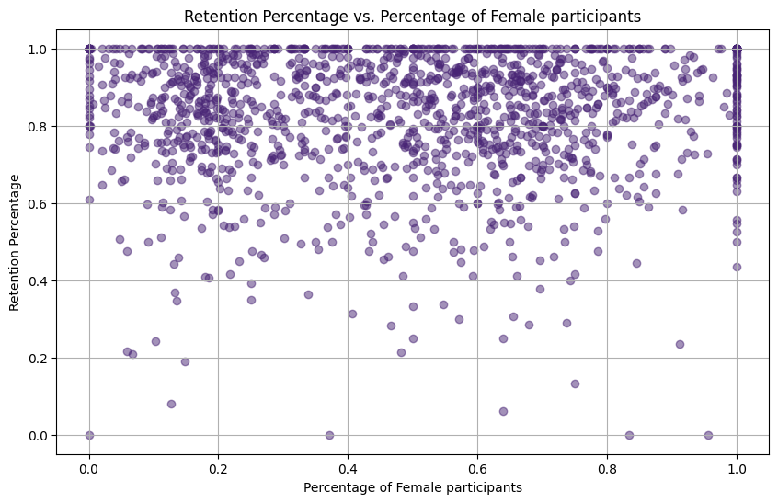
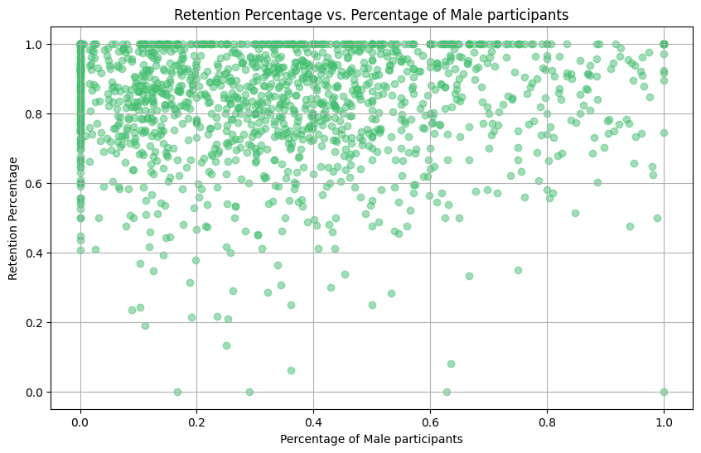
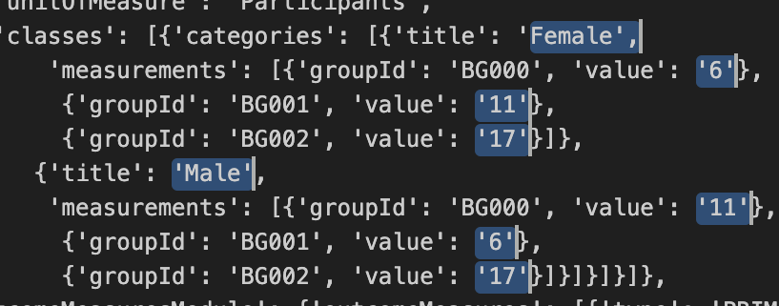

Definition of target variable and set of features
Retention rate =
$$\frac{Number of participants that completed}{Number of participants that started}$$

Slide 5
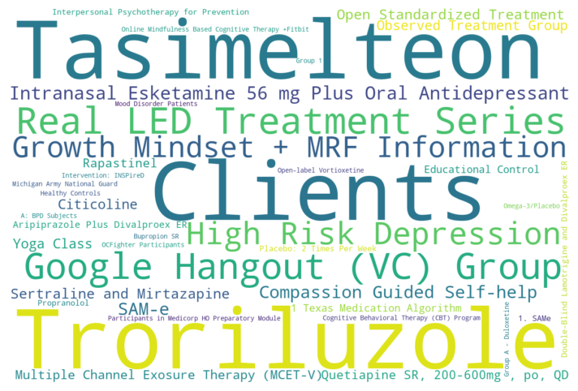
Information extraction and feature engineering?
Common study designs related to low retention
Descriptions of clinical trial
“During the 18-day blind treatment period, subjects will be prescribed Methylphenidate 5-10 mg twice per day and Selective Serotonin Reuptake Inhibitor. Subjects receiving a SSRI when they begin the study, will continue on the recommended dose of that SSRI; subjects not already receiving a SSRI will be prescribed 10-20 mg per day Citalopram. Subjects who respond to methylphenidate treatment will have the option of continuing on methylphenidate, up to 15 mg bid, and an antidepressant in the 6 week open label portion of the study.”
Medication name
Medication dosage
Medication frequency
Use of technology or applications for communication
Timeframe of study stages
“Participants were evaluated weekly for the first two weeks after randomization and then biweekly thereafter till week 12.”
Named Entity Recognition (NER)
OpenAI API / pre-defined entities
Natural language processing packages (e.g sciSpaCy) (Neumann et al., 2019)
Pre-trained & fine-tuned models such as BioBert trained on PubMed abstracts and PMC, or Clinical-Trial Bert (Liu et al., 2022)
Pre-processing
Categorical variables encoding
Missing values handling
Normalisation

Slide 6
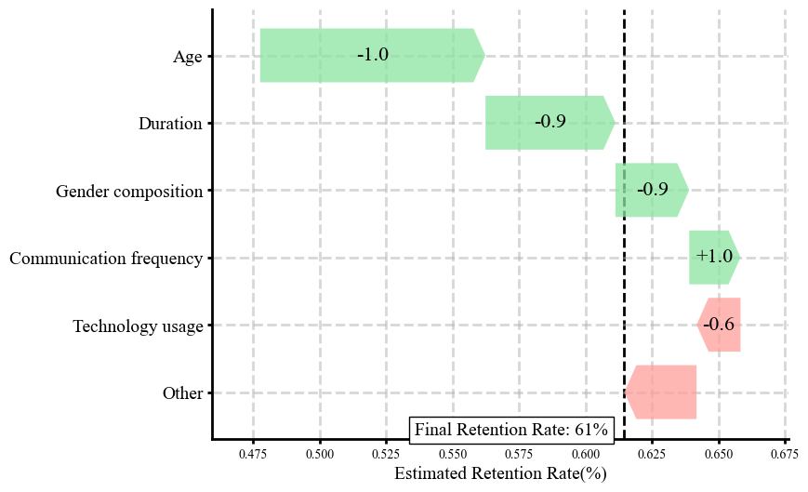
Regressor
Simple machine learning models (e.g. random forest regressor, linear regression)
Training on a set of data with target variable → retention rate
Evaluation using metrics (Mean Squared Error, Mean Absolute Error etc.)
External evaluation on other studies
hold-out test for the same disorders
different disorder
Explainability framework (SHAP) (Lundberg & Lee, 2017)
Multi-class classifier
Examples of classes
Lost follow up
GP decision
Side effects
Death
Mapping
Comparison of different models
Probabilities per class
from chosen classifier

Slide 7
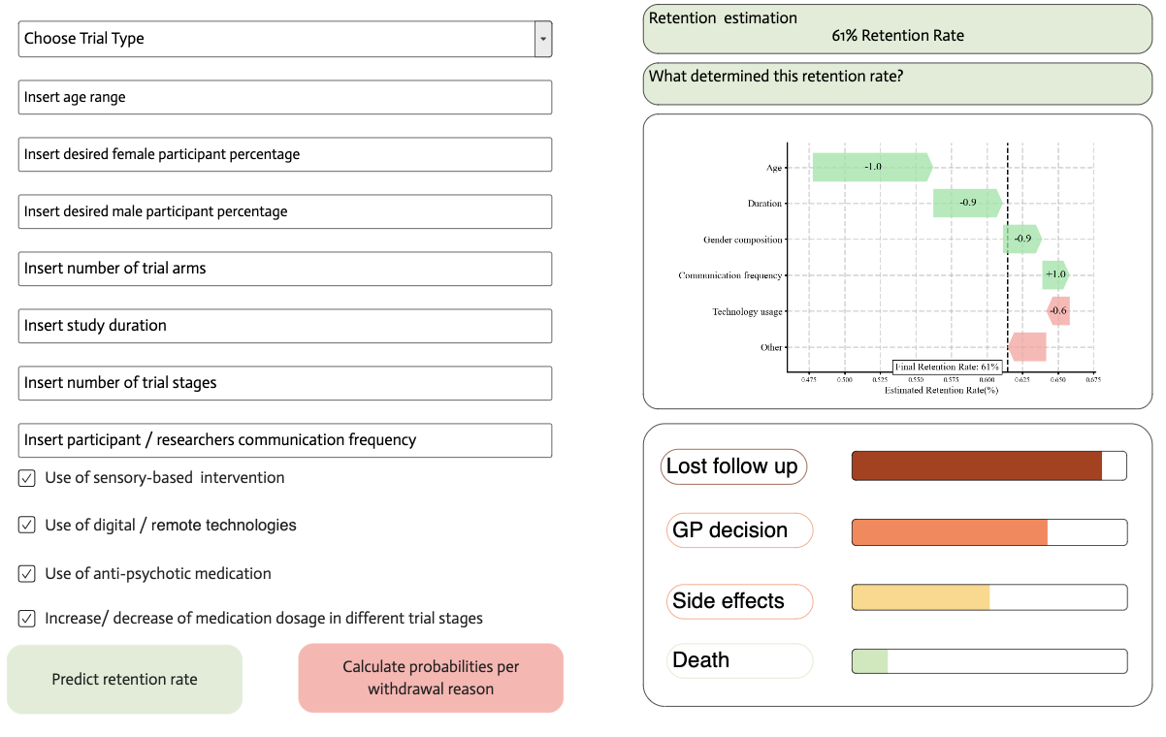
How could this model aid researchers during trial design?

